Slide 1
Presentation
Jiayu Chen
2023.12.12

Slide 2
Work Description
Part_1: 简单的说一说FMM算法
Part_2: 总体流程的详细介绍
信号的预处理；周期分割；重对齐；模板计算与质量筛选；特征提取的尝试；特征提取用于预测的效果
Part_3: 对song给的建议的一些尝试，包括Matched Filter，SG Filter，求导
Part_6: Problems

Slide 3
Part_1

Slide 4
Part_2

Slide 5
信号预处理
信号预处理
周期分割
之前的通过复现论文“”实现了信号质量检测，并过滤掉质量差的信号。
论文中的过滤方法似乎有一些太过严格了 4k条信号筛选结束满足条件的大致472条信号。
然后拿到了Yingjian学长的源代码，BCG_Preprocessing.py里面的那个质量评估函数。它的评估策略比我复现出来的代码要松不少，4672信号还剩下4524条信号。
我采用了Yingjian的预处理方式。
从能够用来预测呼吸和心跳的信号，比能用来提取模板的信号，要更加的杂乱一些。
我和Song老师在上次会议时认为，需要确立合适的标准，再增加一轮的筛选，从而确保信号的质量。
这个筛选的标准，已经解决了，我后面会详细的说
重对齐
模板计算与质量筛选
特征提取的尝试
预测

Slide 6
信号预处理
信号预处理
周期分割
呼吸到底要不要
从模拟数据中反映出的结果来看
计算Template的算法，至关重要
好的计算Template算法，可以抵消呼吸带来的影响
重对齐
模板计算与质量筛选
特征提取的尝试
预测

Slide 7
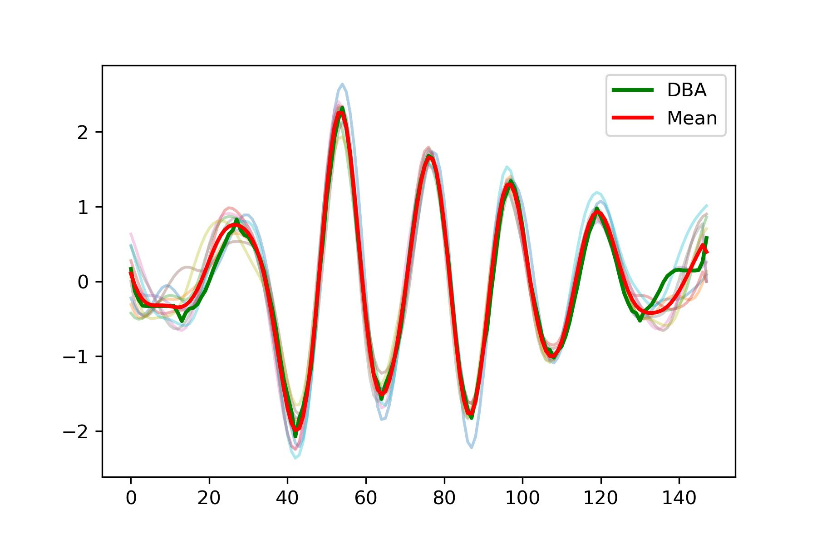
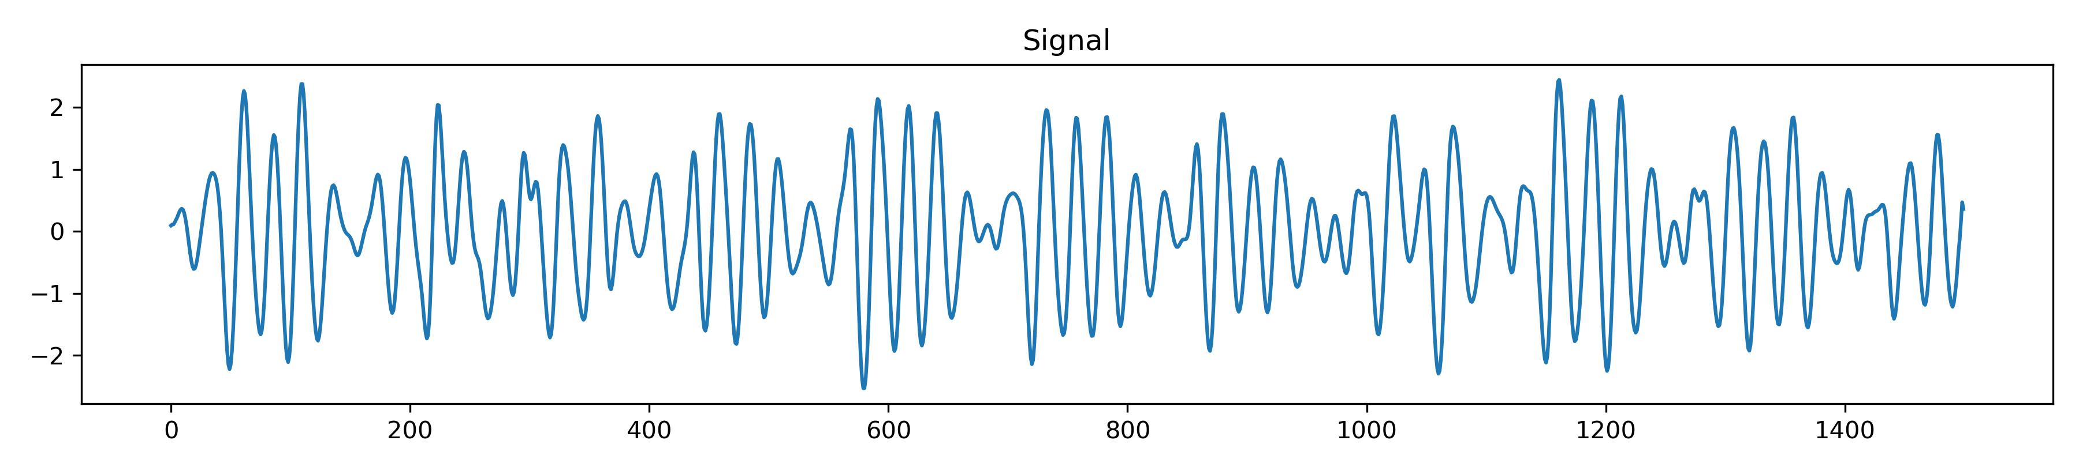
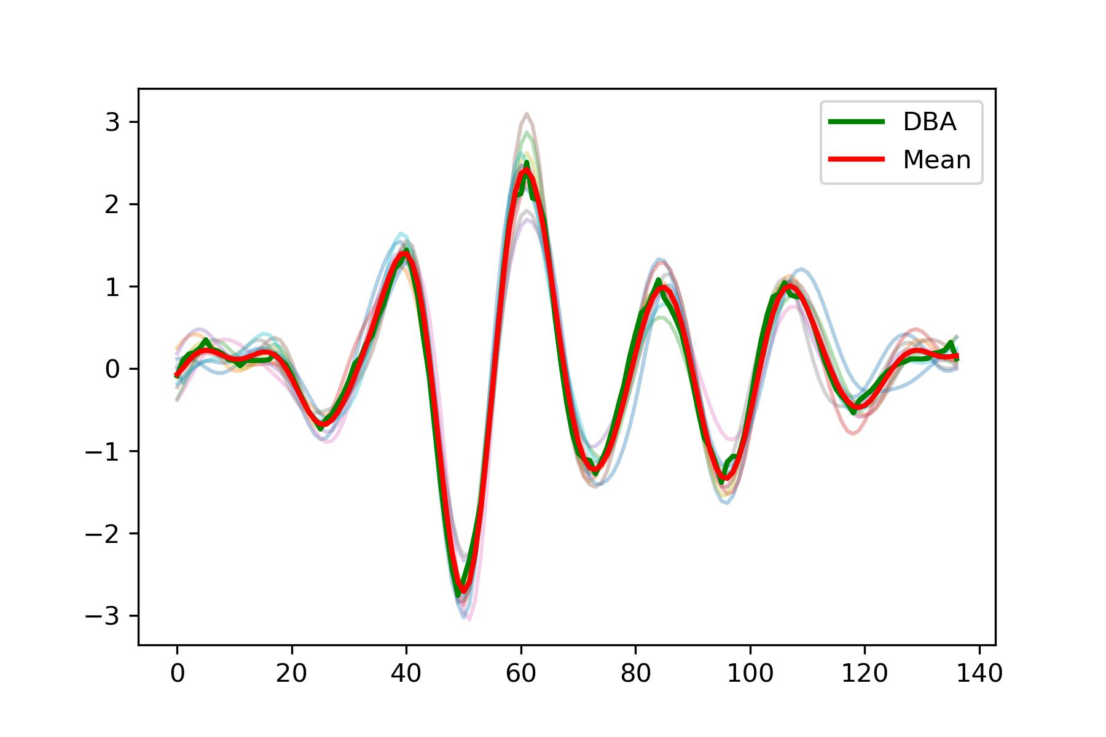
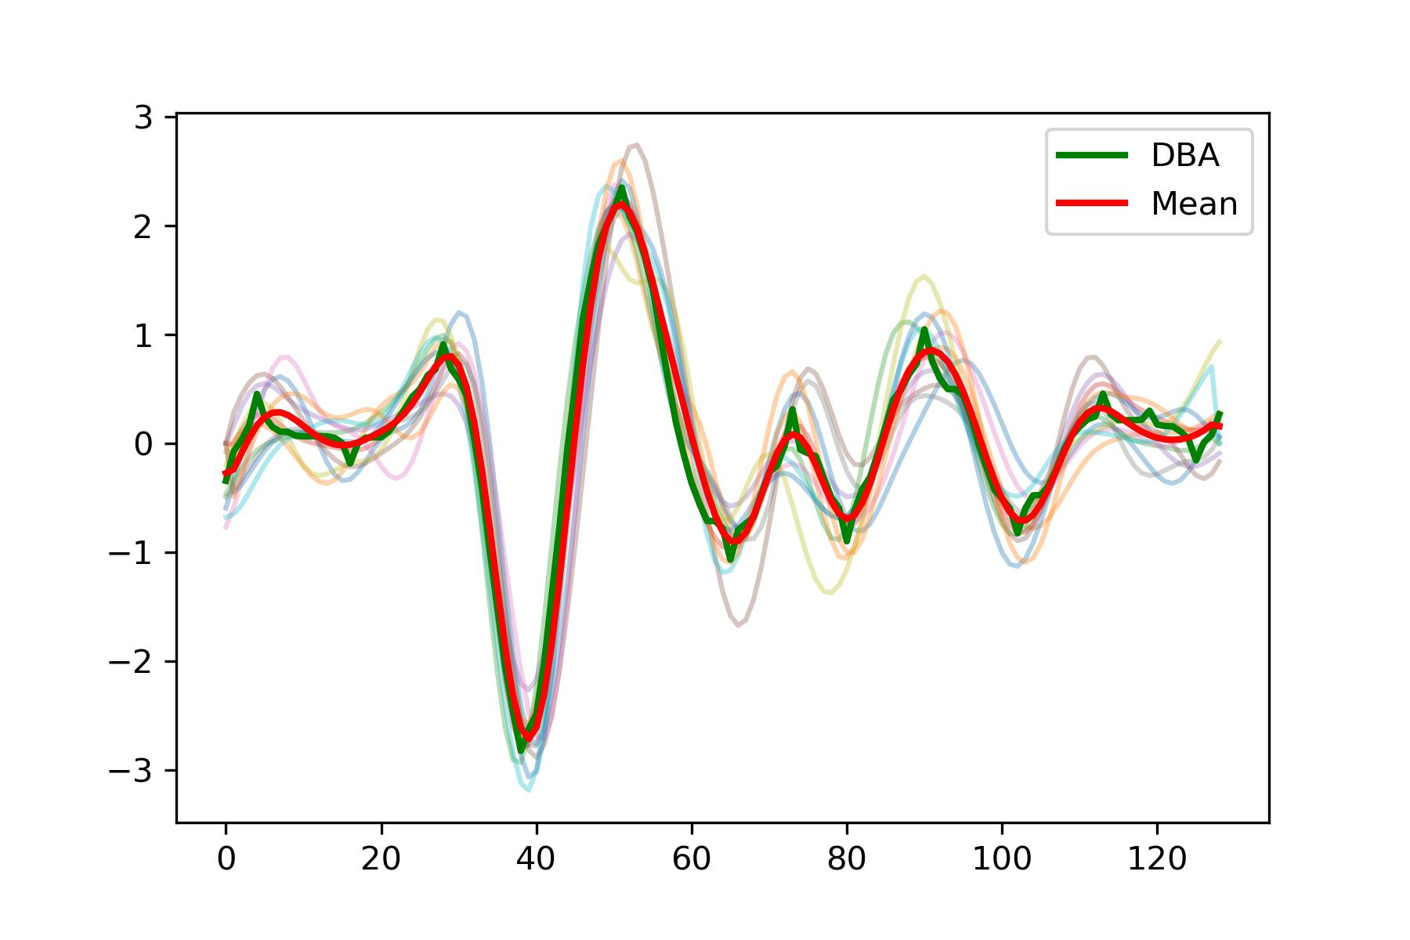
信号预处理
周期分割
周期分割
最大的挑战
- Amplitudes of peaks within each cycle are not consistent.
- Waveforms sometimes resemble SCG, sometimes resemble BCG, and at times fall between the two.
重对齐
模板计算与质量筛选
BCG
SCG
特征提取的尝试
预测

Slide 8
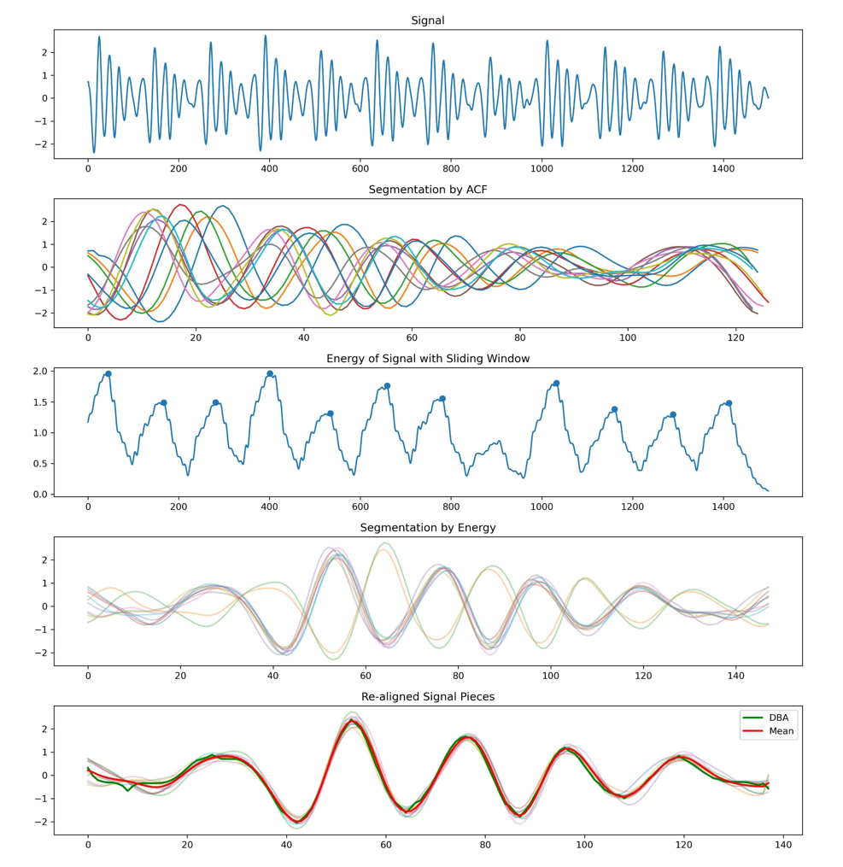
Cut, realign, and extract templates from real signals.
Compared to simulated SCG signals, challenges encountered in real signals are as follows:
Real signals are noisy, multi-peak signals, especially with varying amplitudes among multiple peaks.
The initial section of the signal is often problematic, with periodic incompleteness.
I attempted to utilize an approach presented by Yingjian Song in IoT2023.
While this method is sufficient for estimating heart rate, it is not adequate for accurate segmentation, leading to the following two issues:
Significant and unmanageable errors, making alignment difficult.
The resulting segments are not the desired cycles after the split.
Signal
Hilbert transform for envelope
ACF
Peak Detection
We get
Savitzky-Golay filter
Segmentation
We want

Slide 9
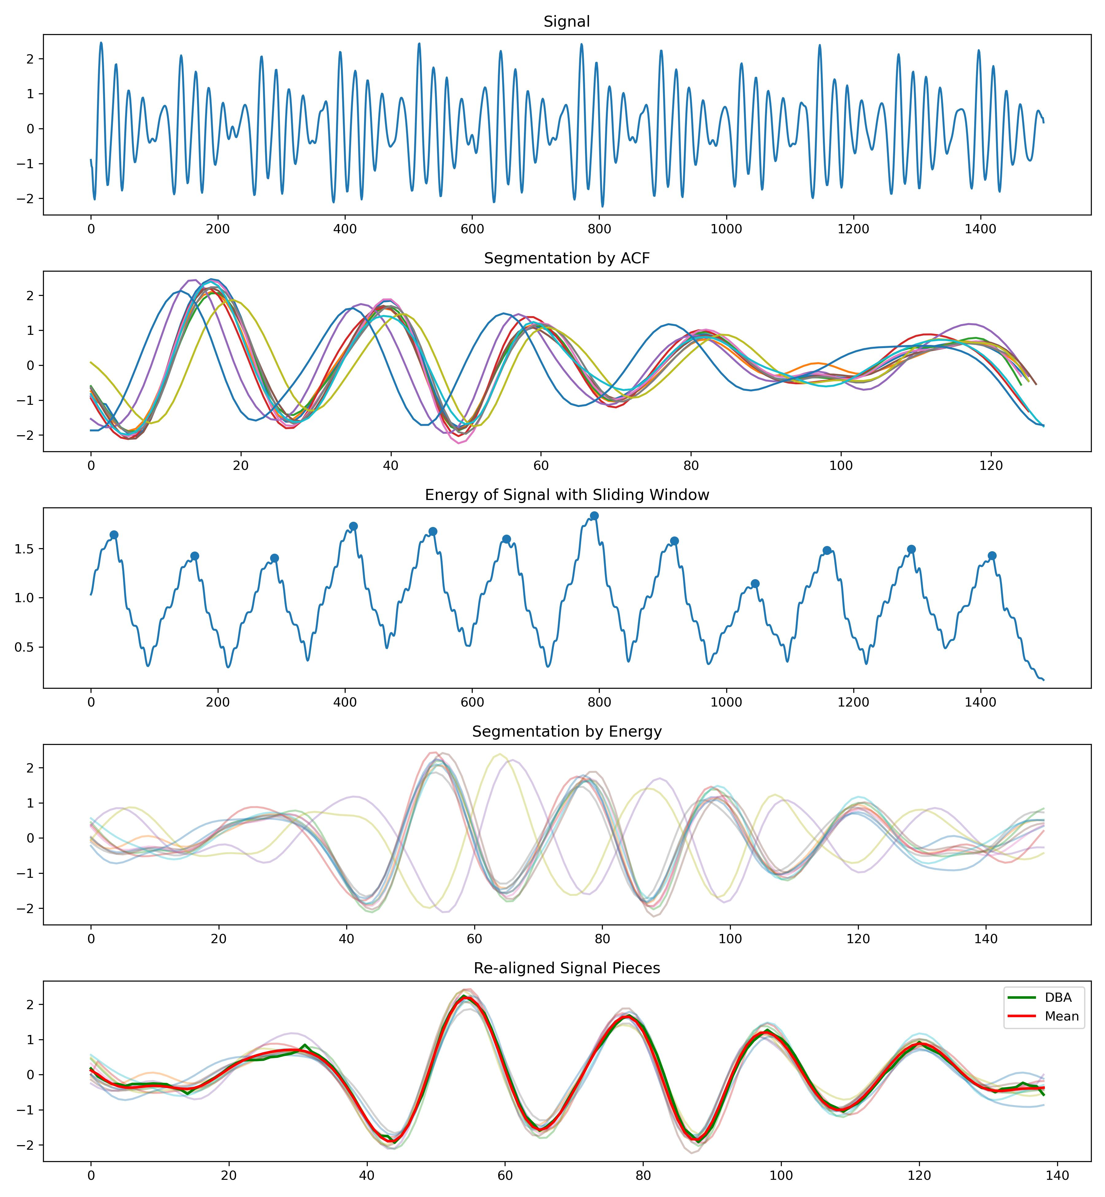
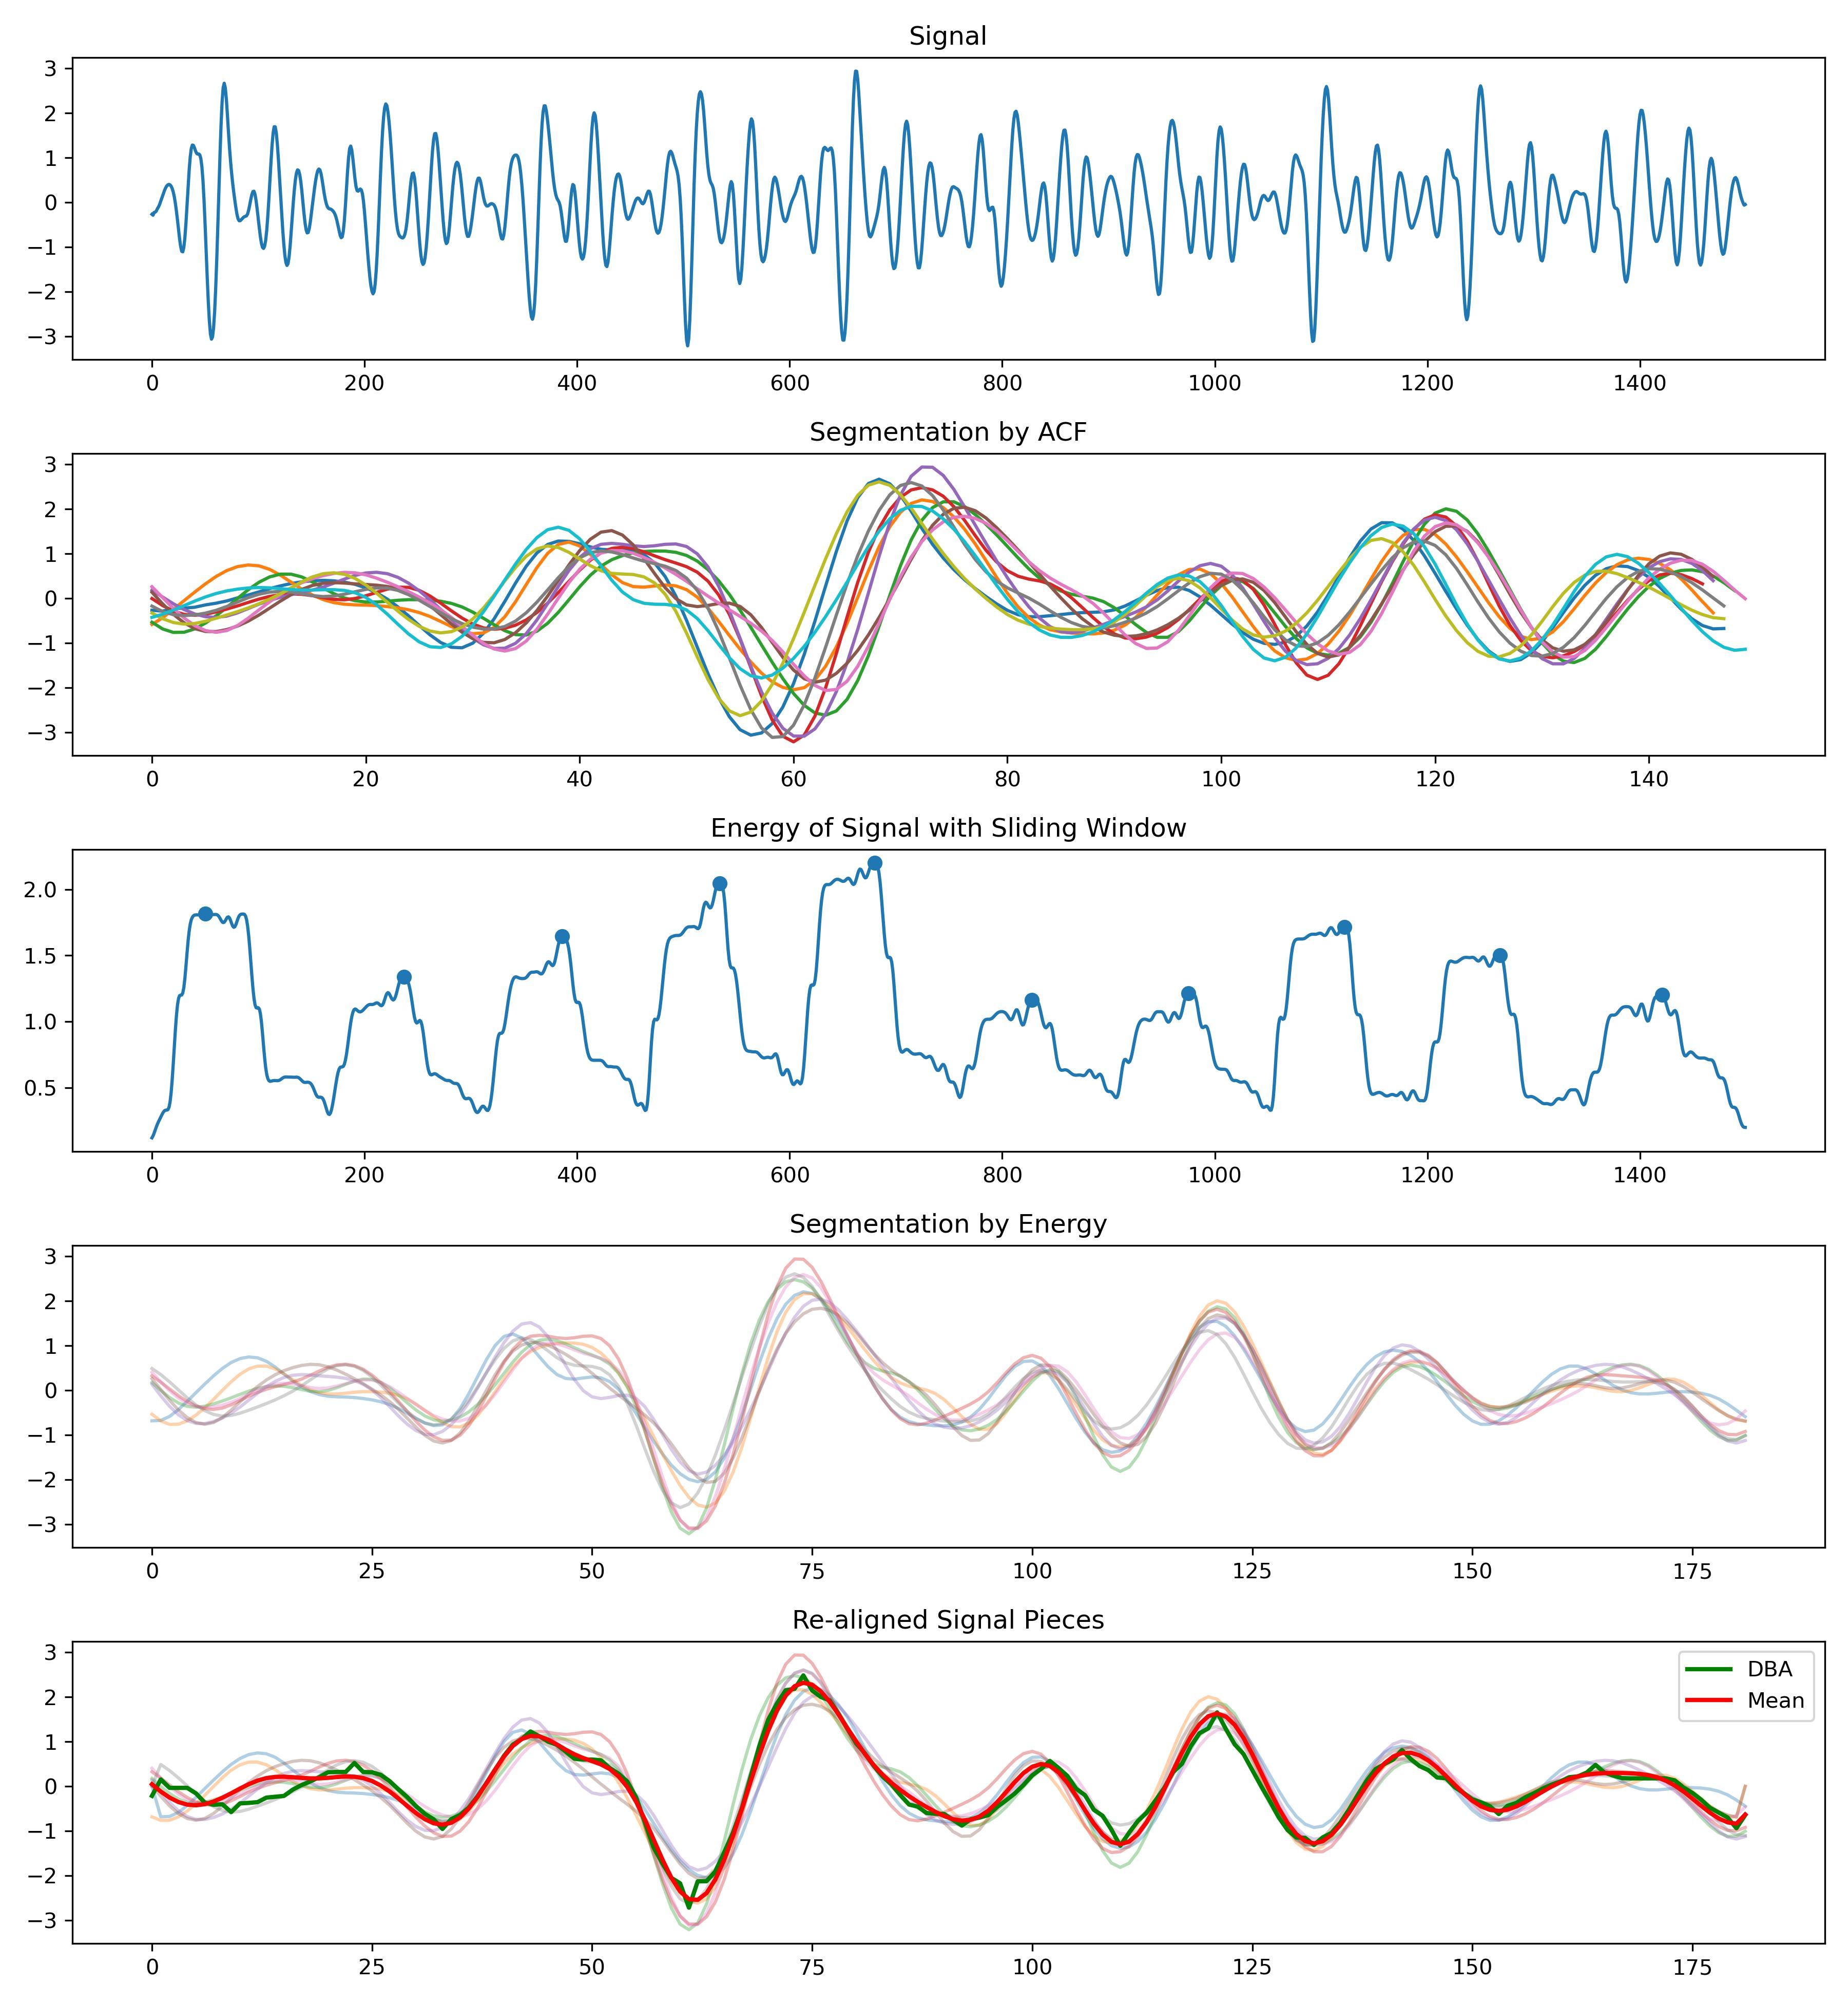
Cut, realign, and extract templates from real signals.
Solution approach:
Is it possible to transform the multi-peak signal in time domain into a single-peak problem in another domain, and ensure that this single peak is relatively fixed within each cycle?
Upon observation, the distribution of energy density within a single cycle of the signal is often relatively stable.
Transforming the multi-peak signal in the time domain into a single-peak problem in the energy density domain.

Slide 10
对比于学长你给出的方法继续做下去，会有一下两个缺陷
除了分割效果更加的稳定以外，还有一个优势就是：
与希尔伯特变化所取的包络线相比，这种方法有一个非常明确的物理含义，对于某一类周期信号，每个周期中能量集中的位置，是相对稳定的

Slide 11
信号预处理
重对齐
周期分割
重对齐
模板计算与质量筛选
特征提取的尝试
预测

Slide 12
Cut, realign, and extract templates from real signals.
The distribution of energy density is often relatively stable, but not completely identical.
To enhance precision, it is necessary to re-align the signals that have already been segmented.
Linear Alignment -> O(T)
Linear Realignment
Without phase variation
Acceptable
One-circle pieces
Non-Linear Alignment -> O(T^2)
With phase variation
Non-Linear Realignment
There is no need for us. Currently, scholars in statistics are working on it.
Unacceptable

Slide 13
Cut, realign, and extract templates from real signals.
Start
Choose one piece x from N pieces X
Calculate the Cross Correlation between x and X[1]
Calculate the Cross Correlation between x and X[N-1]
Add ACF results from N-1 times
Find the appropriate time unit for lag.
Time complexity O(N^3), where N represents the average length of a single cycle.
This algorithm is guaranteed to converge.
Realign piece x.
Get re-aligned pieces

Slide 14
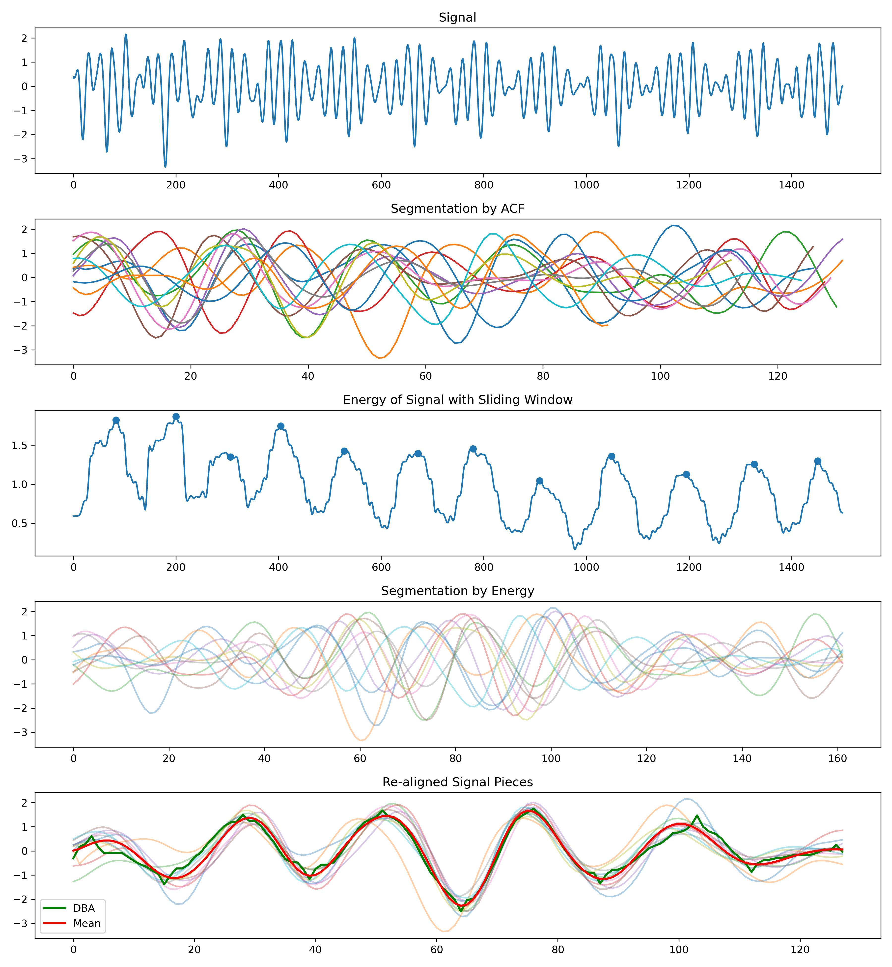
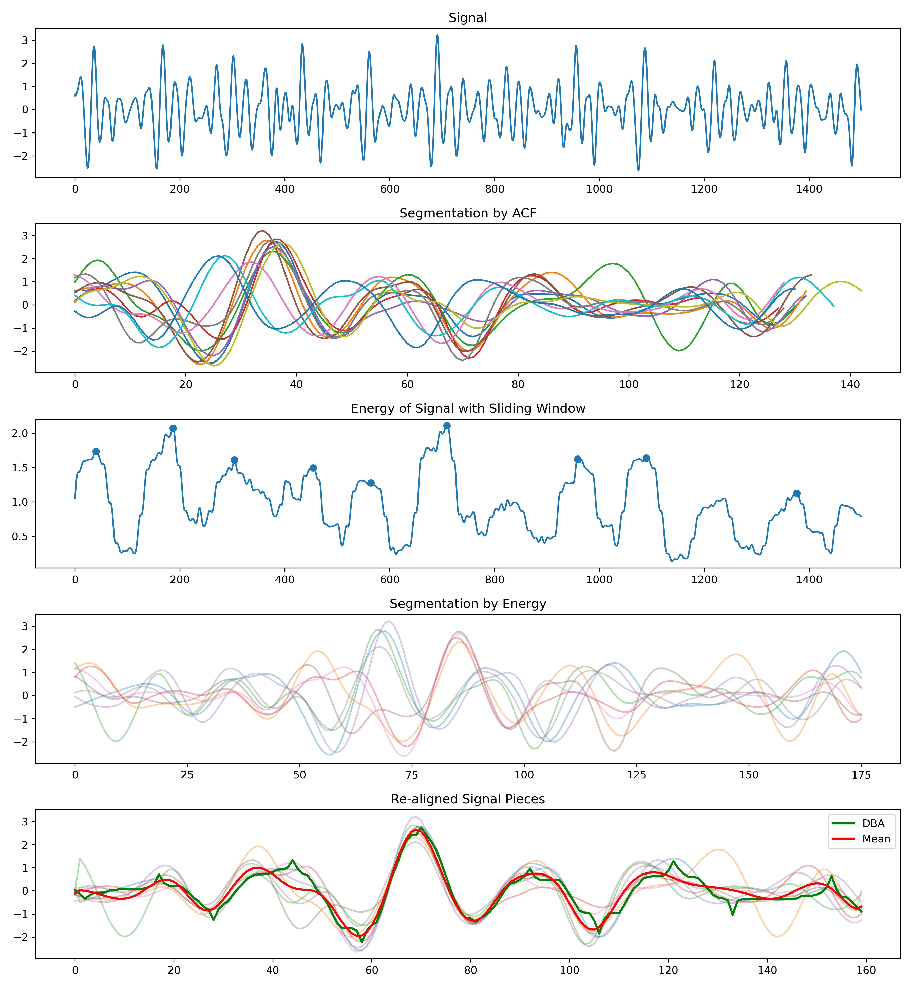
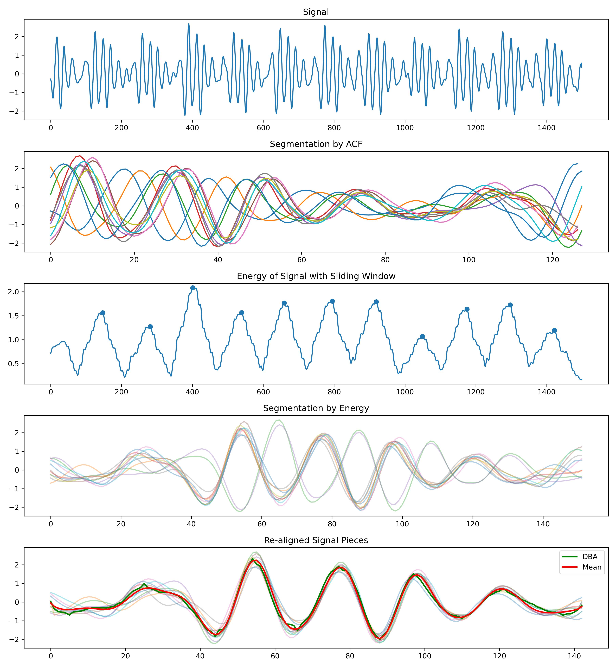
Cut, realign, and extract templates from real signals.

Slide 15
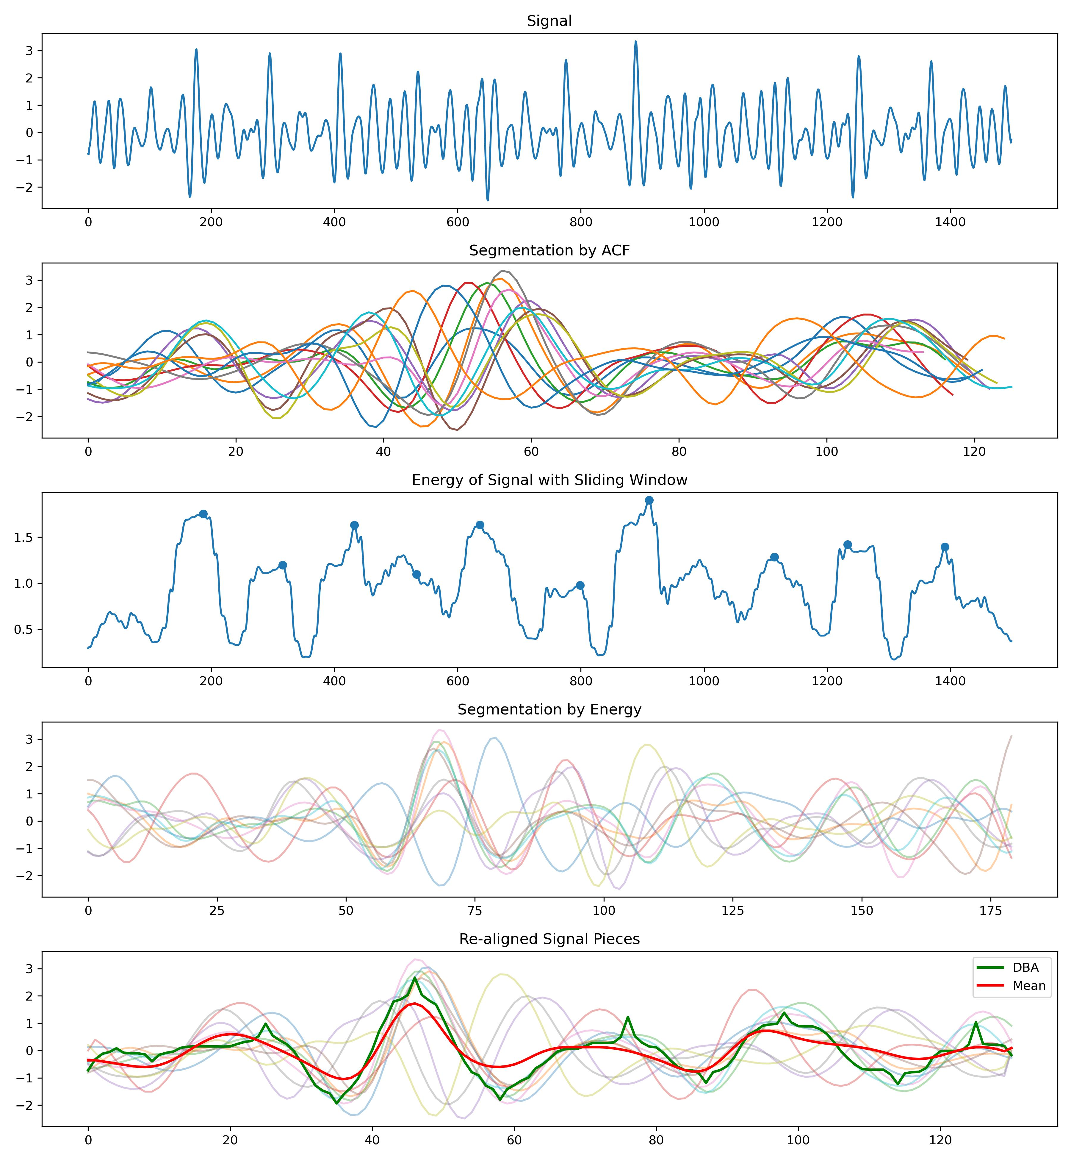
信号预处理
什么样的信号，是能够提取出高质量模板的信号？
周期分割
能不能在求取Template之前，确定这个信号质量好不好
这个问题能不能在信号预处理的时候解决？
重对齐
能
不能
模板计算与质量筛选
寻找一个统计量
基于经验的策略
If…Else
怎么量化判断Template是不是好的
有一些坏的周期，怎么剔除掉
特征提取的尝试
重对齐是否成功，能用于判断Template的质量
预测
对分割完的周期，求取均值
该均值与所有单周期皮尔逊相关系数的平均 是否过低
低于阈值
每个周期之间差异很大
高于阈值
进一步处理，删除掉一些差异很大的周期，进一步过滤信号

Slide 16
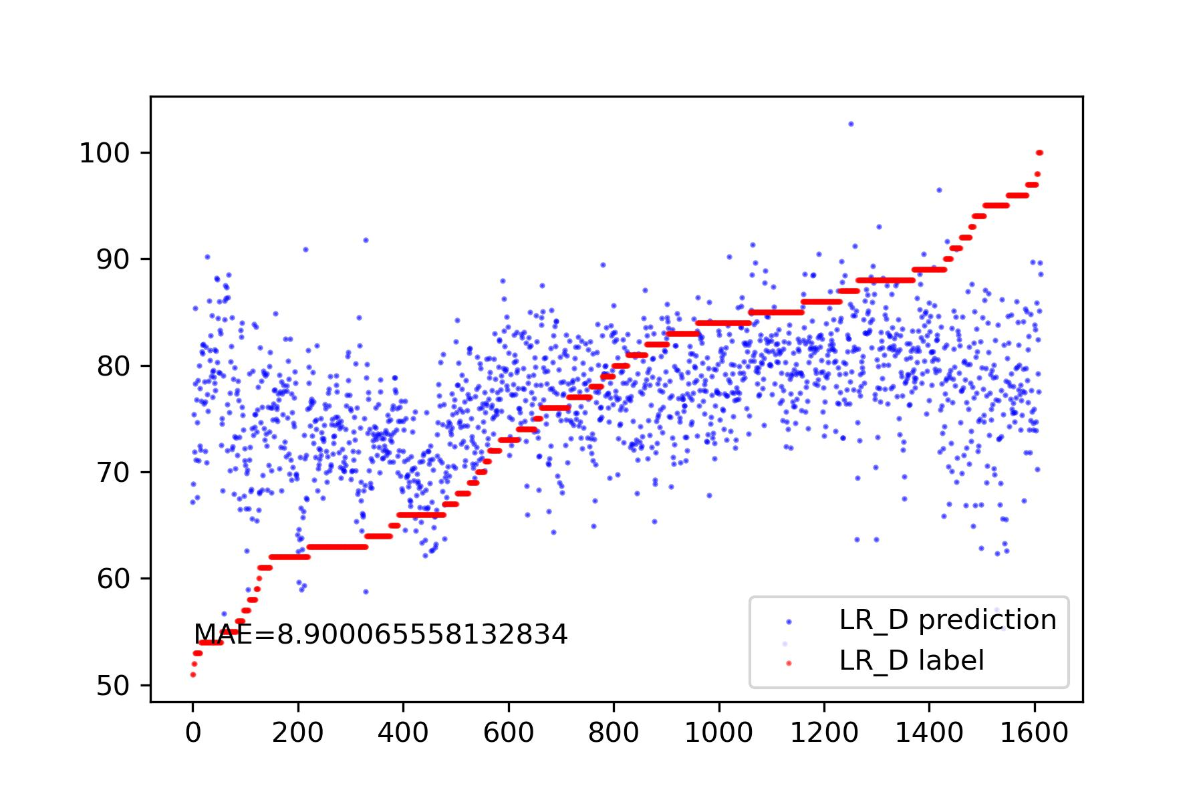
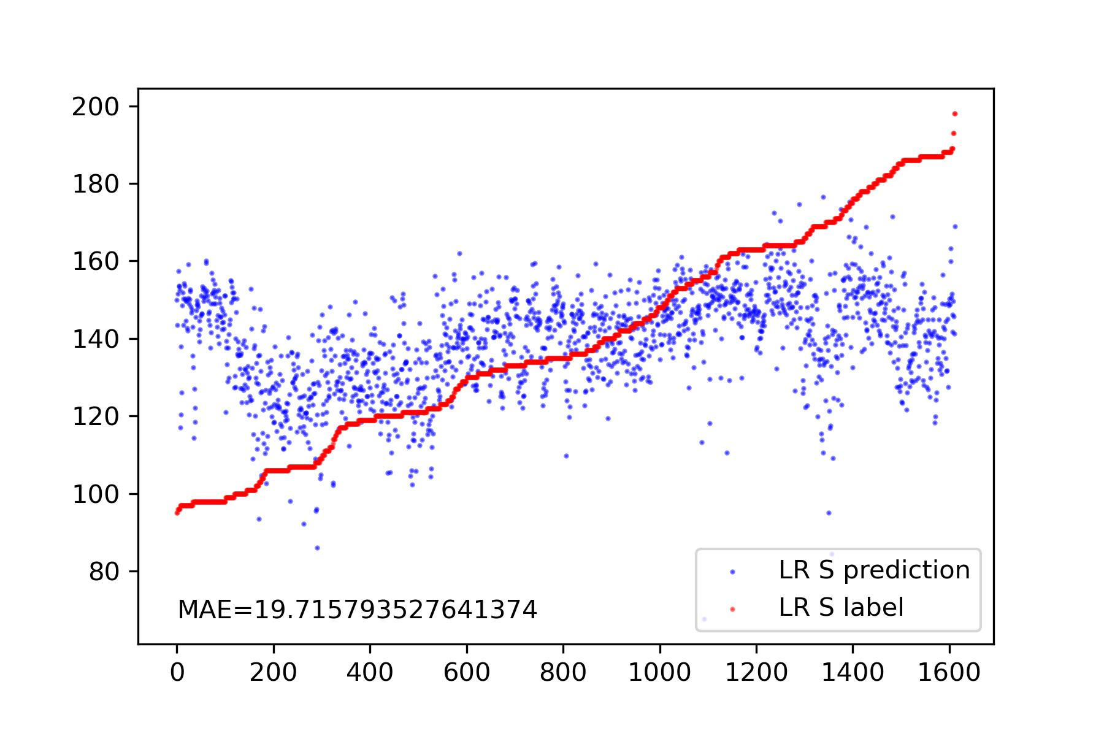
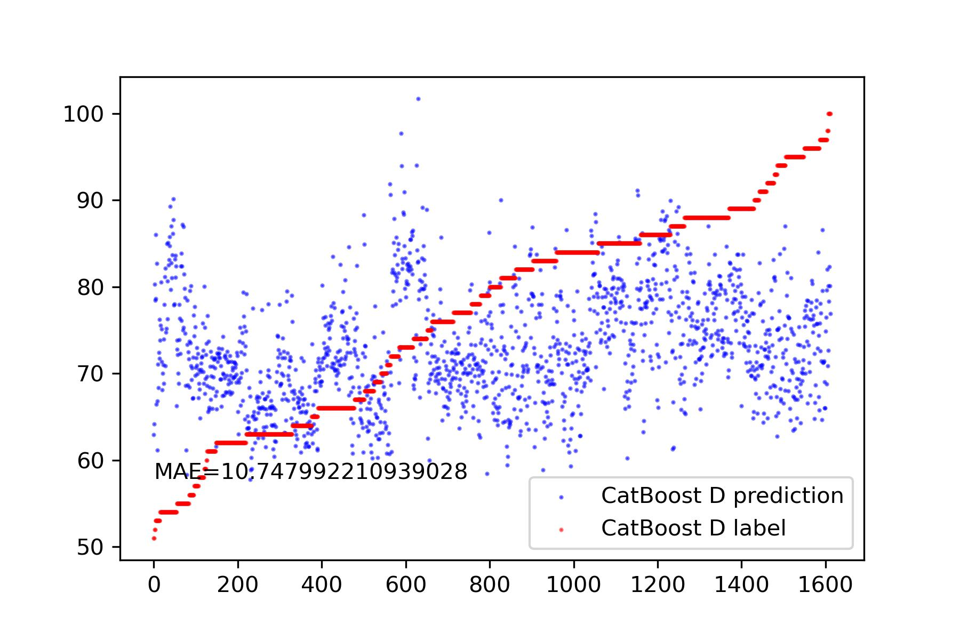
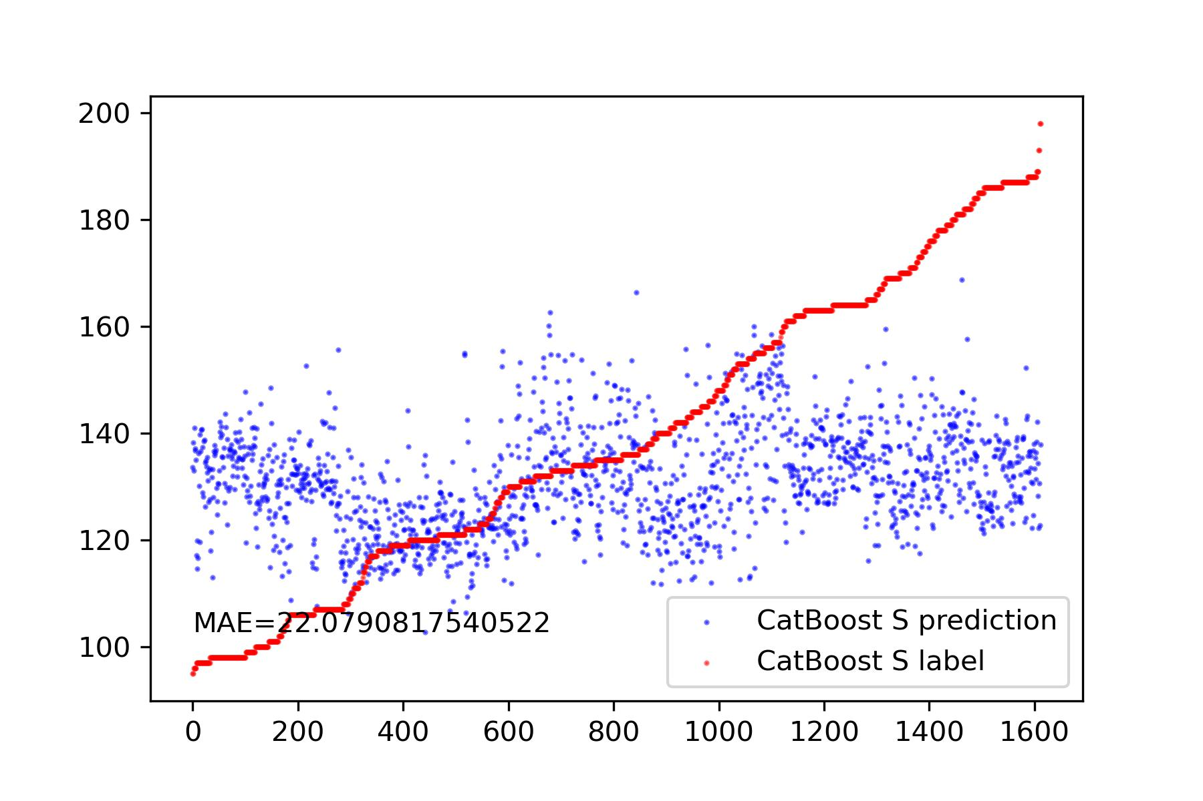
信号预处理
Drop NaN
Linear Regression
Tsfresh 提取出800+个特征
Drop掉方差变化非常小的特征
CatBoost
周期分割
相关性低于0.2的特征
特征提取
重对齐
模板计算与质量筛选
特征提取的尝试
IJK手动提取
预测

Slide 17
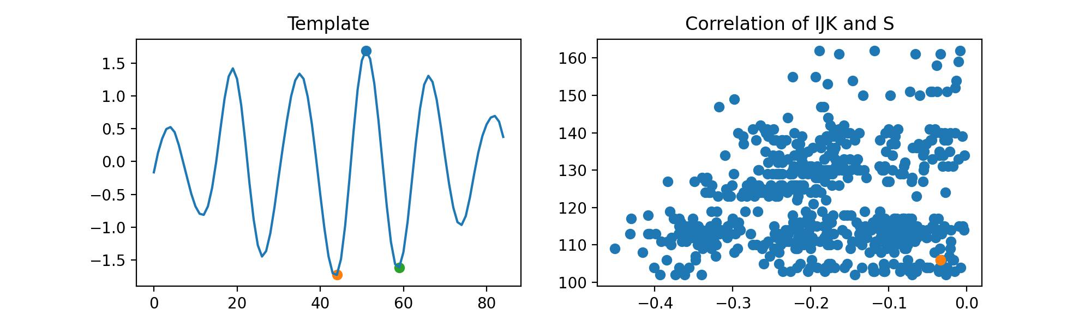
信号预处理
特征提取
IJK
周期分割
以最大的峰为J峰
I和K峰的相对高度有问题
重对齐
模板计算与质量筛选
特征提取的尝试
预测
这种结构，似乎并不在所有的信号中存在

Slide 18
信号预处理
特征提取
IJK
周期分割
重对齐
几乎在所有的信号中存在
模板计算与质量筛选
特征提取的尝试
预测

Slide 19
Part_3

Slide 20
An easy experiment about sampling rate.
The impact of different sampling rates on time series alignment.
Model | Data | Sampling Rate | Resample Method | S | D
Template: Mean | Simulation | 100 | - | 1.35 | 4.53
Template: Mean | Simulation | 100->150 | FFT | 0.95 | 3.24
Template: Mean | Simulation | 100->150 | POLY | 0.95 | 2.98
Template: Mean | Simulation | 150 | - | 0.92 | 2.36
Model | Data | Sampling Rate | Resample Method | S | D
Template: Mean | Simulation | 100 | - | 1.35 | 4.53
Template: Mean | Simulation | 100->200 | FFT | 0.70 | 2.47
Template: Mean | Simulation | 100->200 | POLY | 0.64 | 2.07
Template: Mean | Simulation | 200 | - | 0.65 | 1.75
Conclusion:
Resampling signals with low sampling rates can significantly improve the performance. Within a certain range, a higher sampling rate is better.
The resampling mode has a significant impact on the results, with FFT and POLY yielding completely different effects.

Slide 21
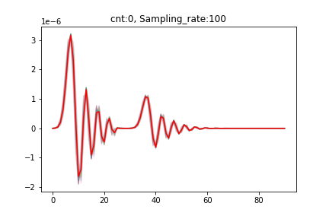
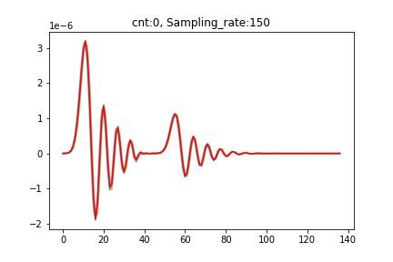

An easy experiment about sampling rate.
Principle of accuracy improvement
With the increase in sampling rate, originally relatively separated peaks gradually come closer together.
In addition, the more the number of time points, the higher the fault tolerance.
So the error decreases.
Resample
Low Sampling Rate
High Sampling Rate

Slide 22
Part_4

Slide 23
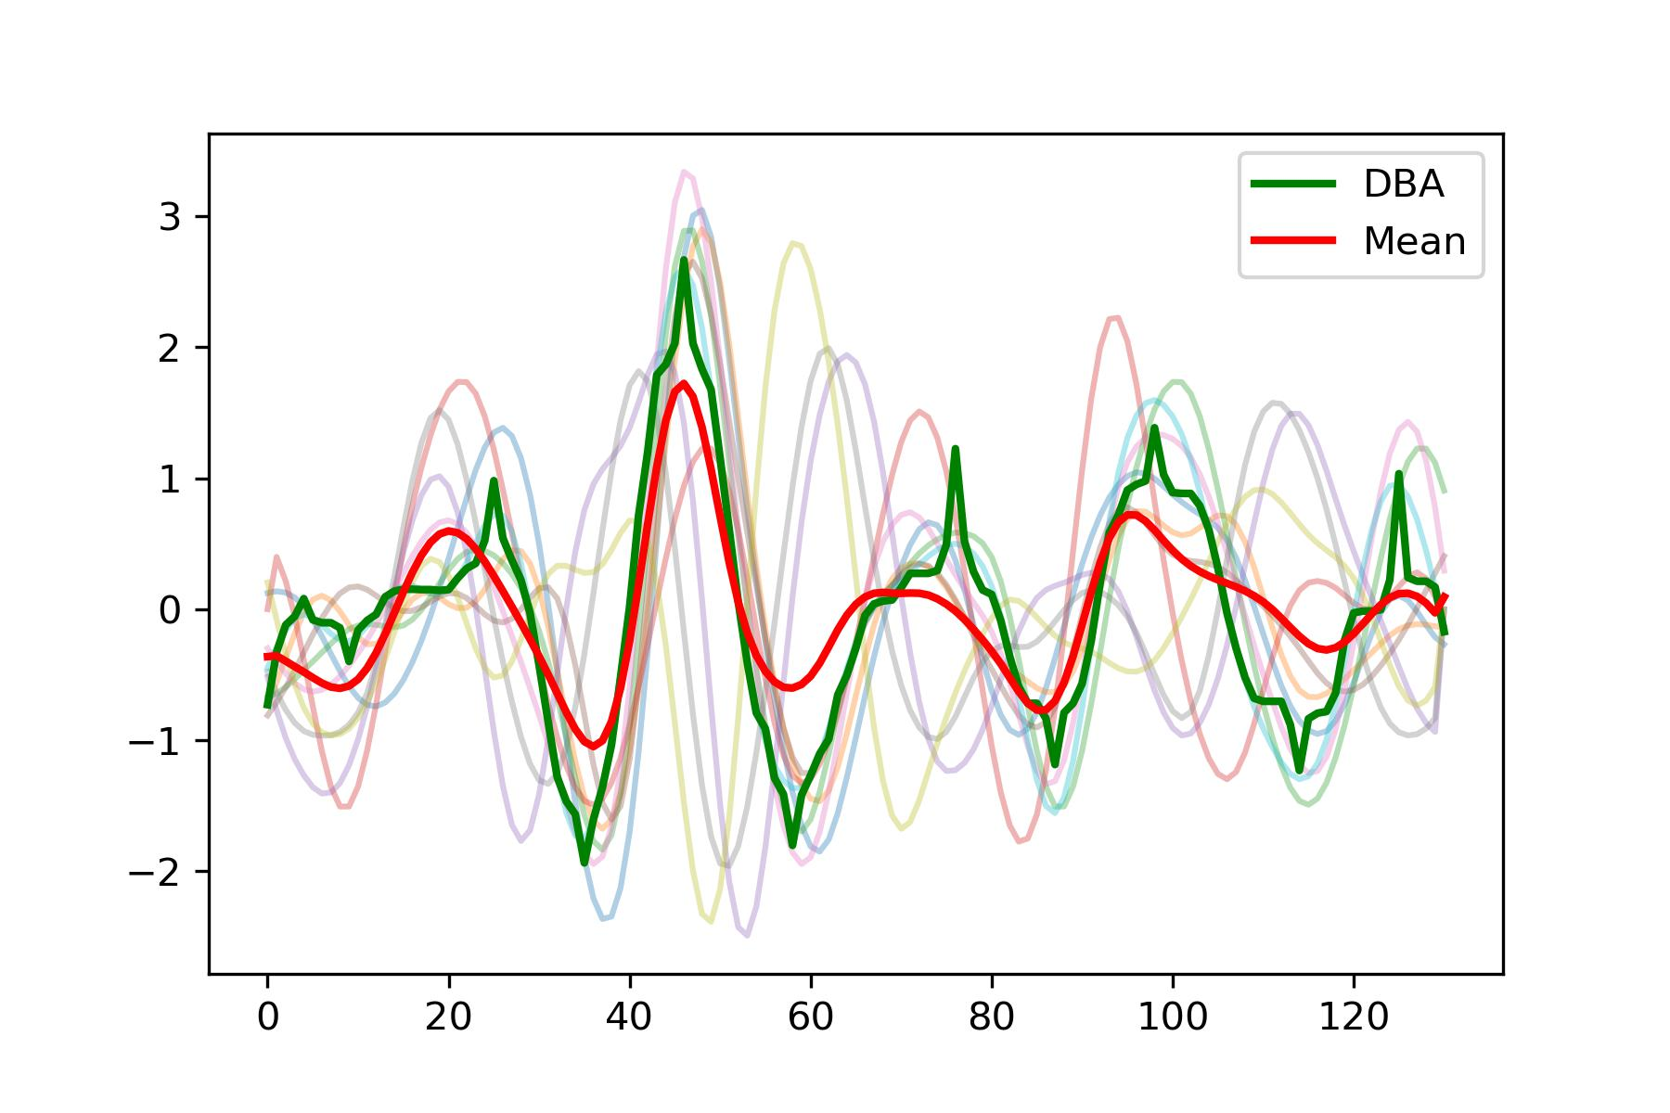
Cut, realign, and extract templates from real signals.
Signal quality:
For heart rate calculation, the previous filtering algorithm has performed well. However, for template extraction and feature analysis, it is not sufficient and requires an additional filtering layer.
The quality of the signal is in a critical state.
It is possible to extract a template that is barely satisfactory.

Slide 24
Part_5

Slide 25
Questions
If we want to precisely understand the BedDot BSG signal, do we need to simultaneously measure a person's SCG, BCG, and BSG signals to explore the relationships between these three signals? Are there any papers that have simultaneously measured SCG and BCG signals? I haven't found relevant papers.
If I were able to propose a segmentation, re-alignment, and innovate an effective template calculation method (with MAE < 3 on SCG simulated signals), and suggest a metric for evaluation, in what field would this likely be presented at a conference?

Slide 26
Thanks!

Slide 27
Why doesn’t FMM work
Advantages of FMM (from emails by authors):
“particularly when dealing with pronounced spike waves”
“The FMM model is specifically effective at identifying high peaks against the background noise”
“to detect other less prominent peaks more components could be added.”
Disadvantages of FMM (from the demo code):
We must decompose a single-cycle signal into a large number of components, if we want to focus on smaller peaks.
After decomposition, the relationship between these components becomes chaotic. There is a loss of interpretability in decomposed components.
We can only use FMM to denoise one-circle signal.

Slide 28
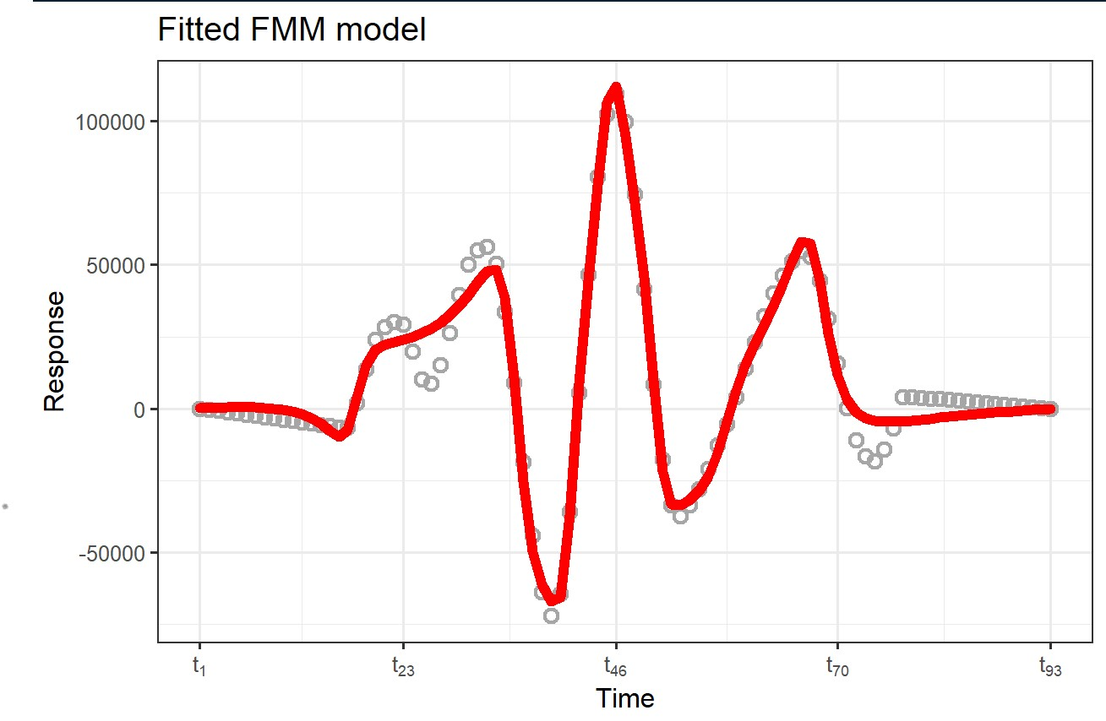
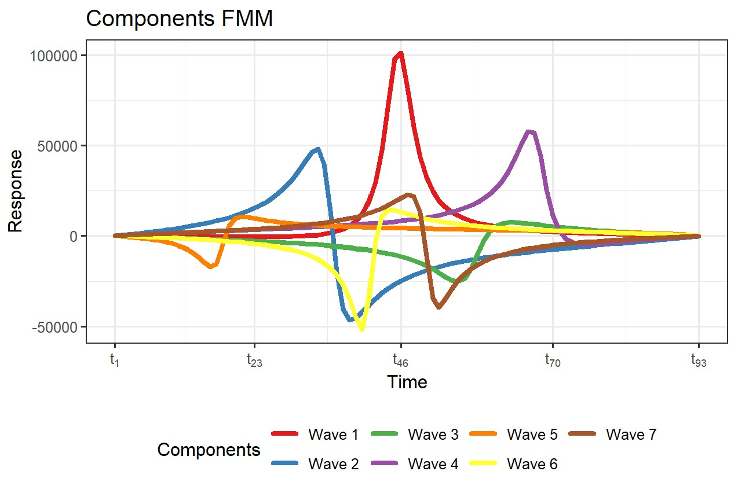
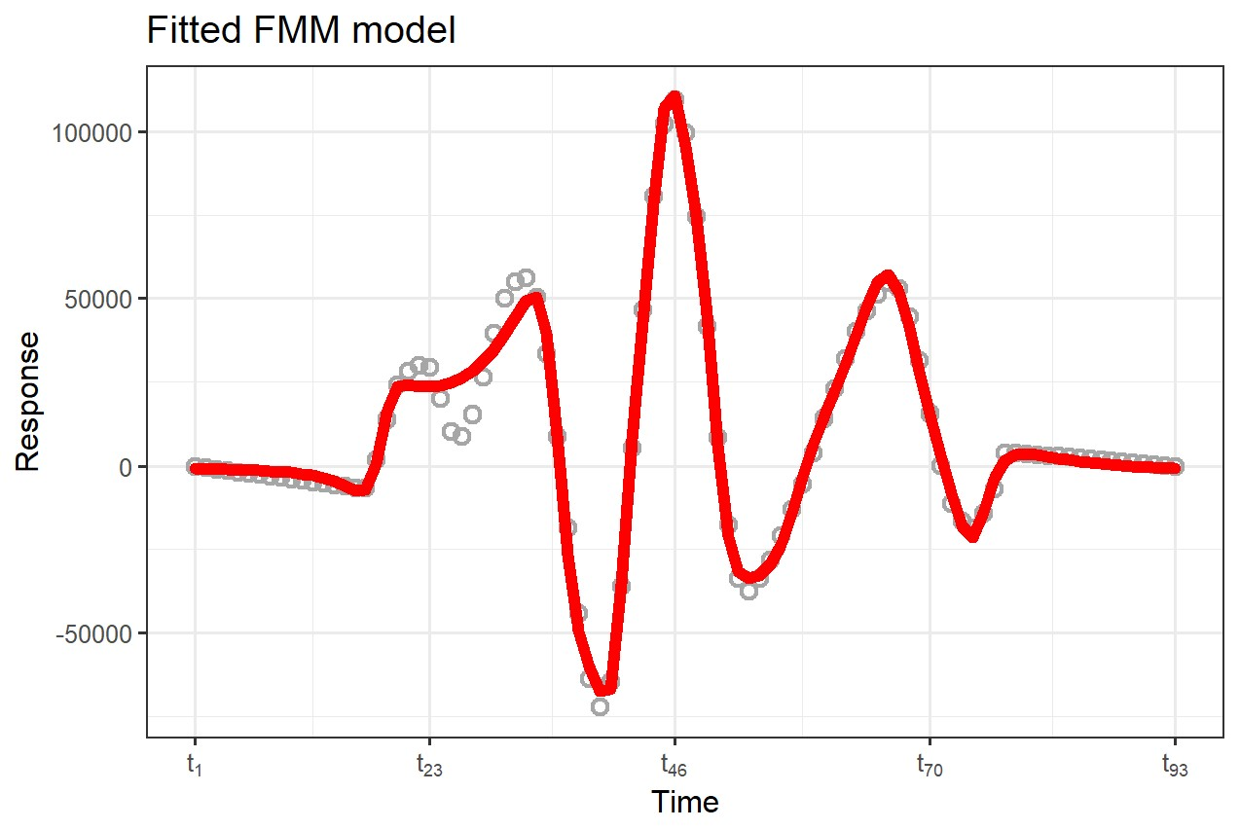
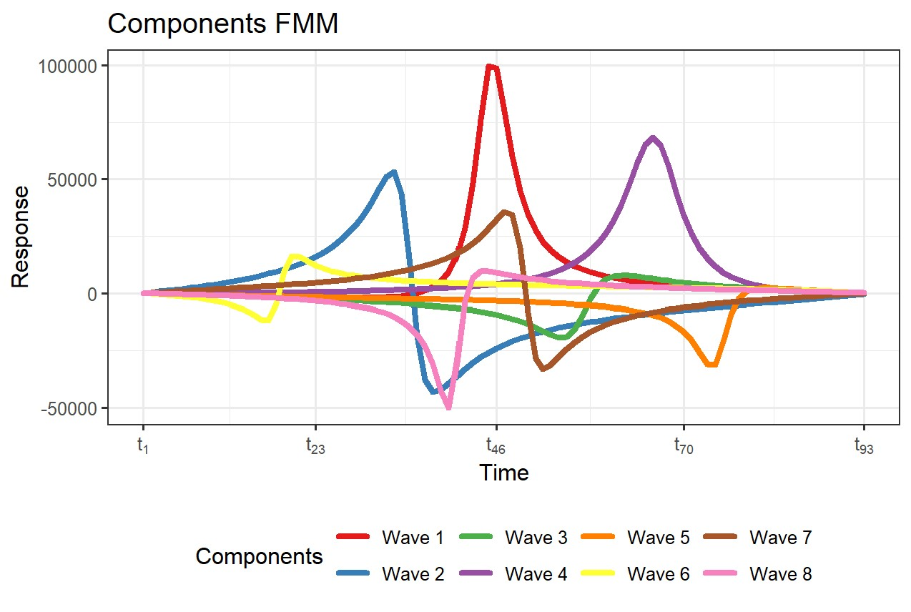
Why doesn’t FMM work
There is almost no interpretability in decomposed components.
We need to decompose a single-cycle signal into a large number of components, if we want to focus on smaller peaks.

